Slide 1
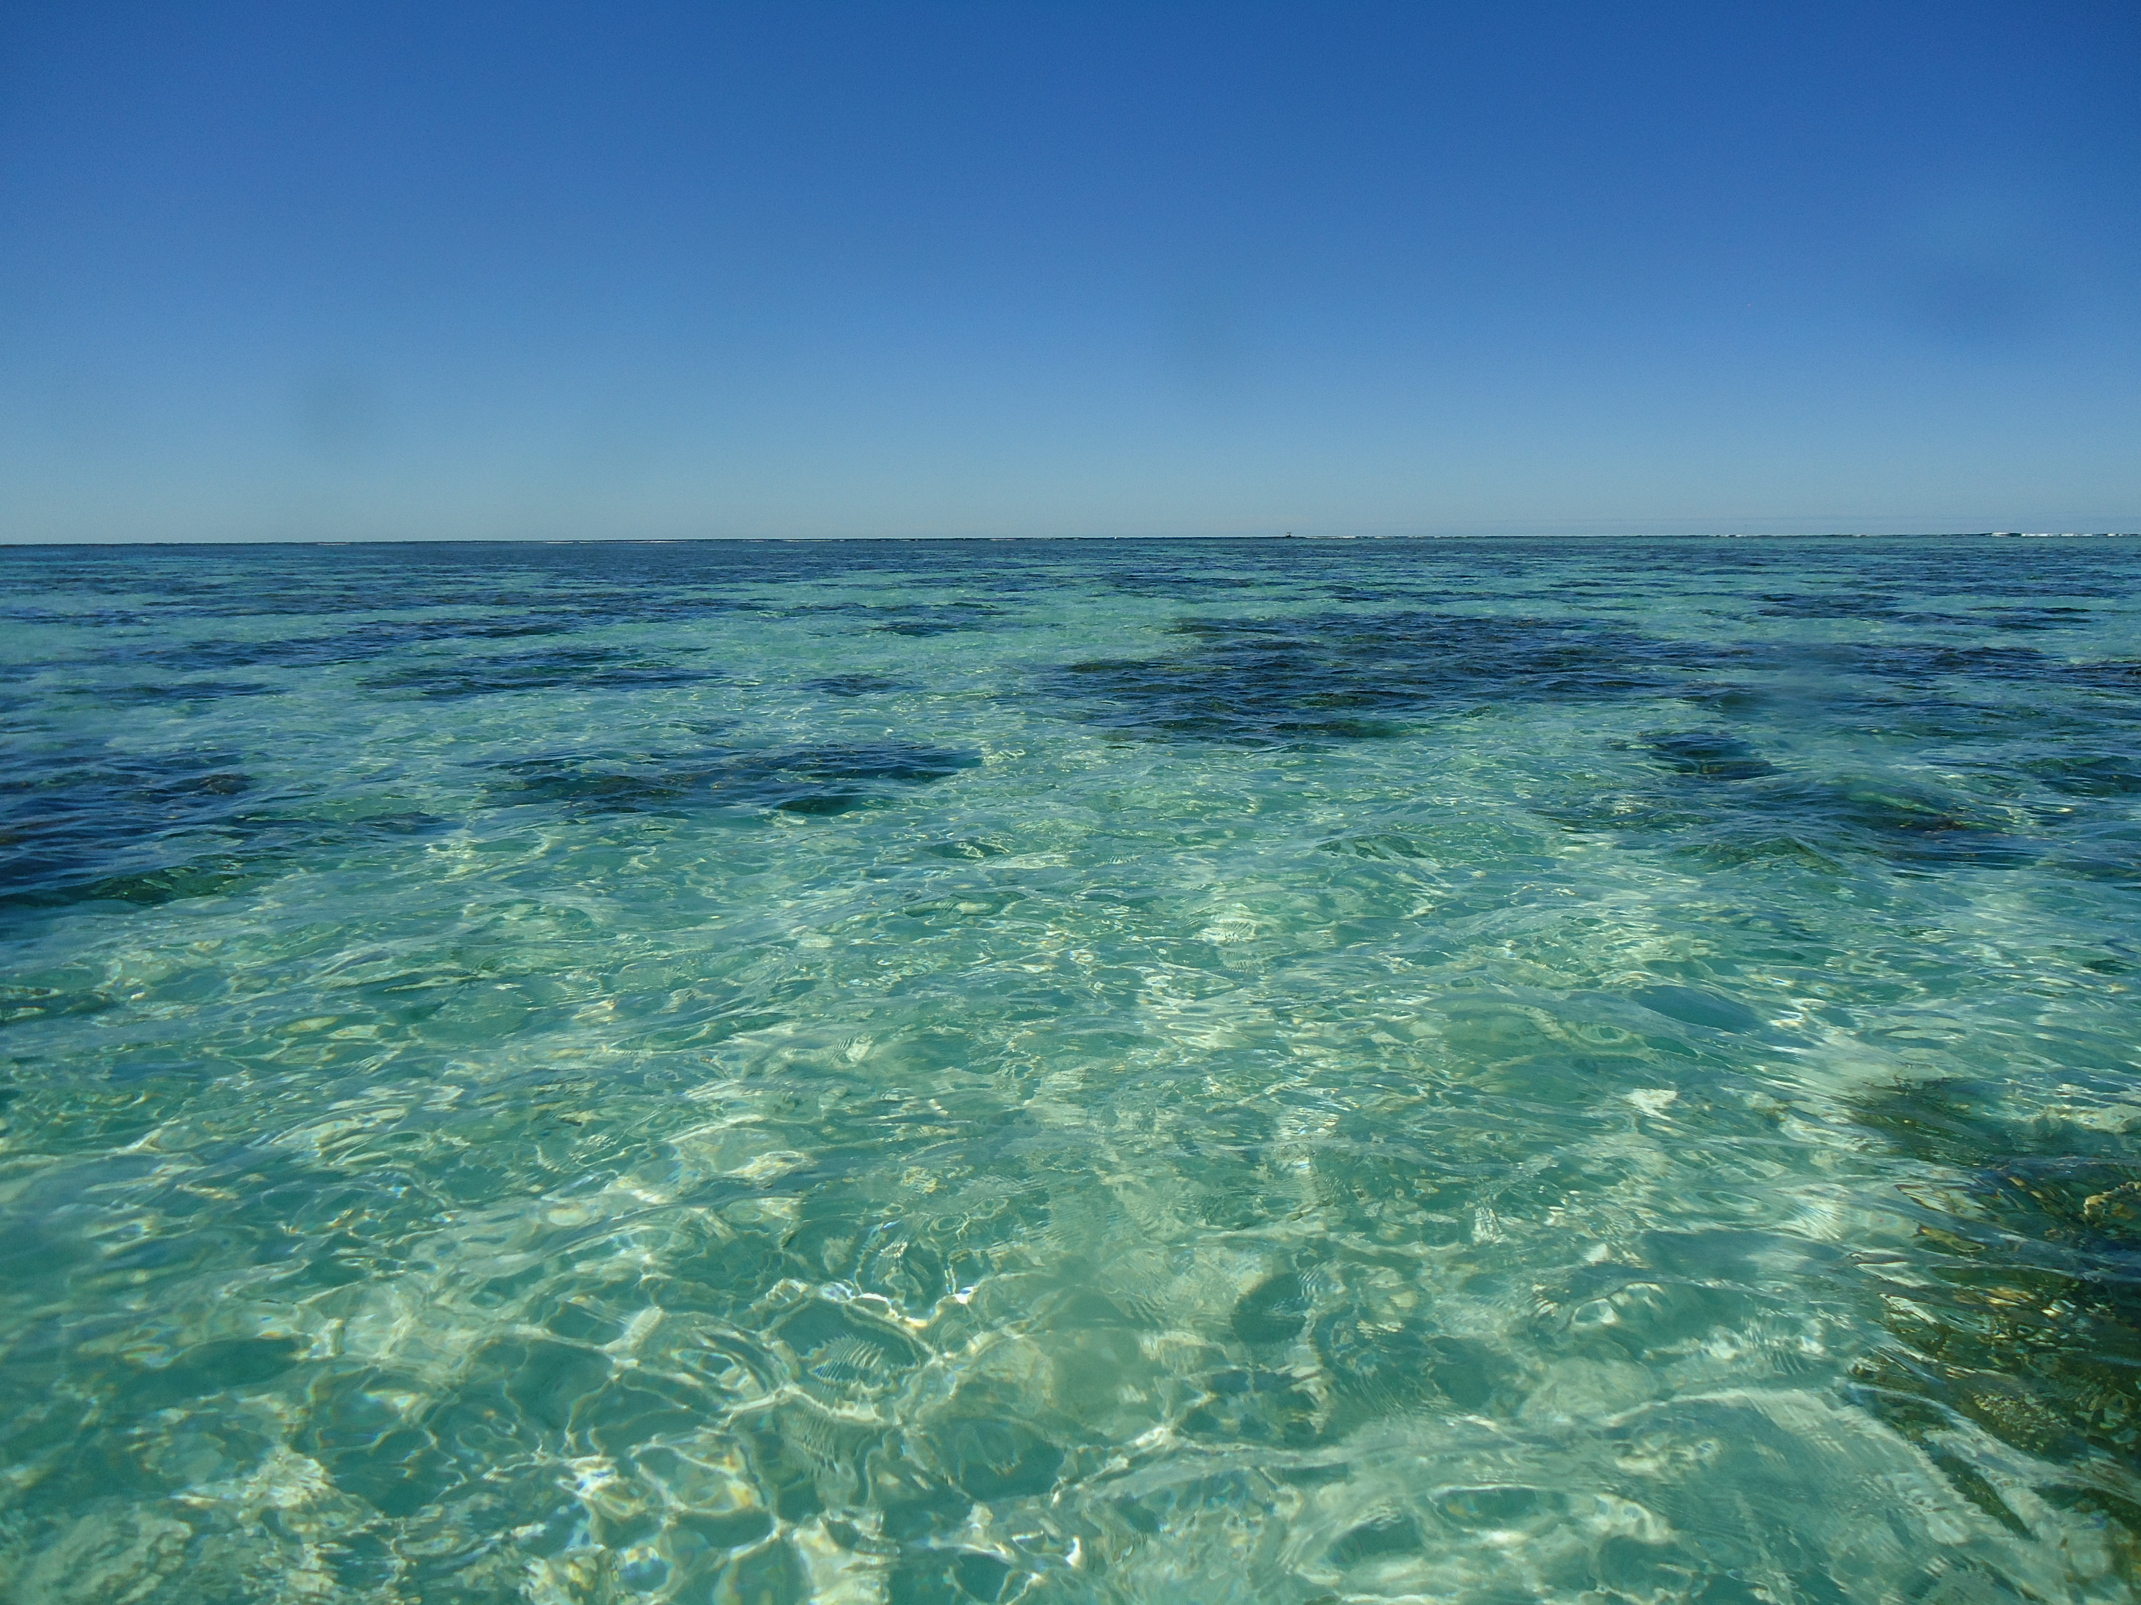
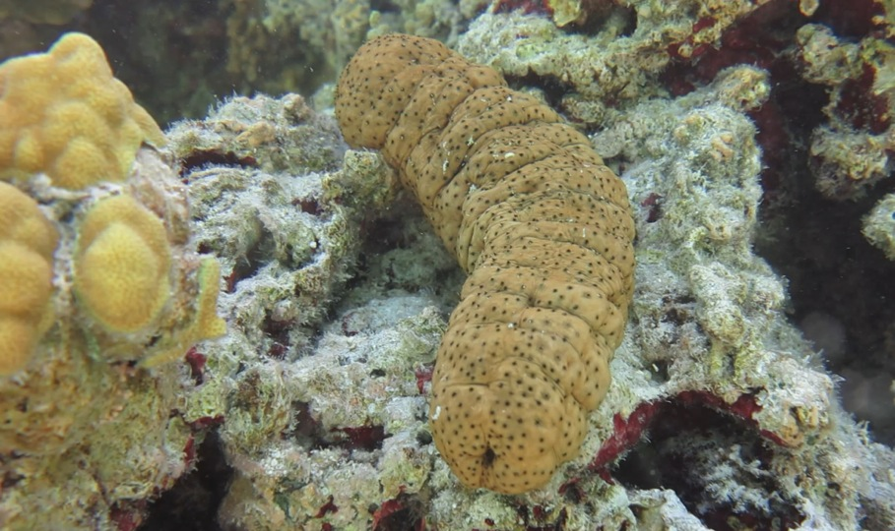
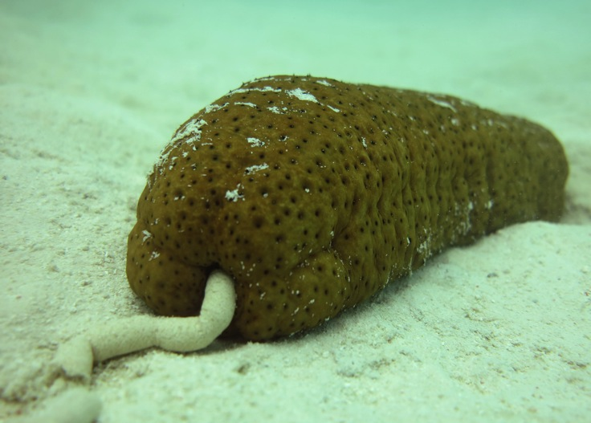
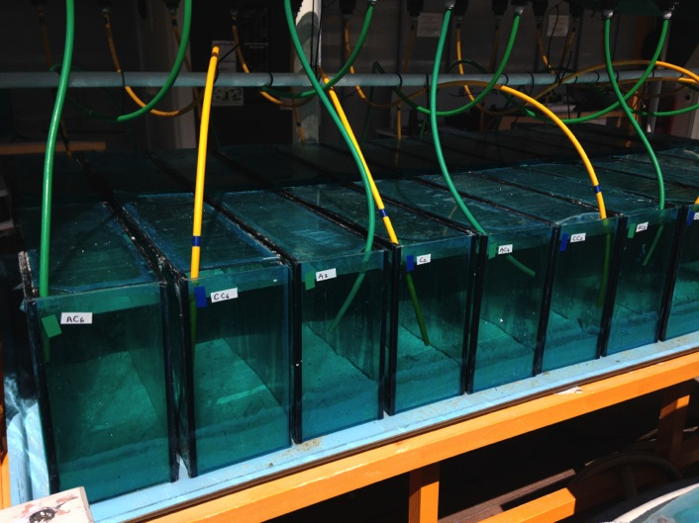






Biogenic buffering by sea cucumbers reduces nighttime dissolution on coral reefs
Kennedy Wolfe¹, Francisco Vidal-Ramirez², Sophie Dove², Maria Byrne¹
¹ School of Medical and Biological Sciences, The University of Sydney, NSW
² School of Biological Sciences, The University of Queensland, QLD
Introduction - On coral reefs, deposit feeding sea cucumbers influence local carbonate chemistry through their digestive physiology and dissolution of calcium carbonate (CaCO₃) sediment⁽¹⁾ (Fig 1a). Resulting changes in total alkalinity (A_{T}) and dissolved inorganic carbon (DIC) could alter the buffer capacity (A_{T}:DIC) of seawater⁽²⁾. By influencing the A_{T}:DIC ratio, biogenic buffering by sea cucumbers may have the potential to partially ameliorate the negative effects of ocean acidification, improving conditions for coral reef calcifiers.
Methodology - Mesocosms (Fig 1b) were set up at Heron Island Research Station (HIRS) reflecting the local lagoon sediment habitat, and were acclimated at present-day and near-future pCO₂ (+570 µatm). Mesocosm conditions fluctuated with the natural temperature/pH levels recorded in situ on Heron Reef⁽³⁾. The influence of Stichopus herrmanni on seawater chemistry was determined from discrete water samples taken across day and night incubations in mesocosms with and without sea cucumbers.
a.
b.
Fig 1: a) S. herrmanni bioturbation, b) mesocosm set up at HIRS
Daytime
Negative dissolution (calcification) occurred (Fig 2a)
pH and A_{T}:DIC increased across all mesocosms (Fig 2b).
Changes in water chemistry were greater in mesocosms without sea cucumbers.
The presence of S. herrmanni had a drawdown effect on daytime calcification and A_{T}:DIC
Nighttime
CaCO₃ Dissolution was highest at night and elevated pCO₂ (Fig 2a).
pH and A_{T}:DIC decreased across all mesocosms (Fig 2b).
Changes in water chemistry were greater in mesocosms without sea cucumbers.
Mesocosms with S. herrmanni were 20-25% higher in pH and had a buffer capacity 20-33.3% higher than mesocosms without sea cucumbers.
Fig 2: Changes in a) dissolution, and b) buffering capacity across day and night incubations in mesocosms with (+cuc) and without S. herrmanni.
Conclusions
Reductions in net calcification of coral reefs have been largely attributed to increases in nighttime dissolution as opposed to reductions in daytime calcification^{(4,5)}.
Biogenic buffering by S. herrmanni (and likely other sea cucumbers) at night may be particularly important in reducing community dissolution, thereby contributing to the maintenance of coral reef structures.
This may increase in importance as ocean pH decreases over coming decades.
As a species recently listed as vulnerable to extinction due to commercial overharvest, our findings highlight the potential negative effect of the global béche-de-mer fishery to coral reef chemistry and future reef resilience.
References
⁽¹⁾Schneider K et al. (2013) Estuar Coast Shelf Sci, 133:217-223.
⁽²⁾Zeebe (2012) Ann Rev Earth Planet Sci, 40:141-165.
⁽³⁾Dove S et al. (2013) PNAS, 110:15342-15347.
⁽⁴⁾Silverman J et al. (2012) J Geophysical Res, 117: G03023.
⁽⁵⁾Yamamoto S et al. (2012) Biogeosciences, 9:1441-1450.

