Slide 1
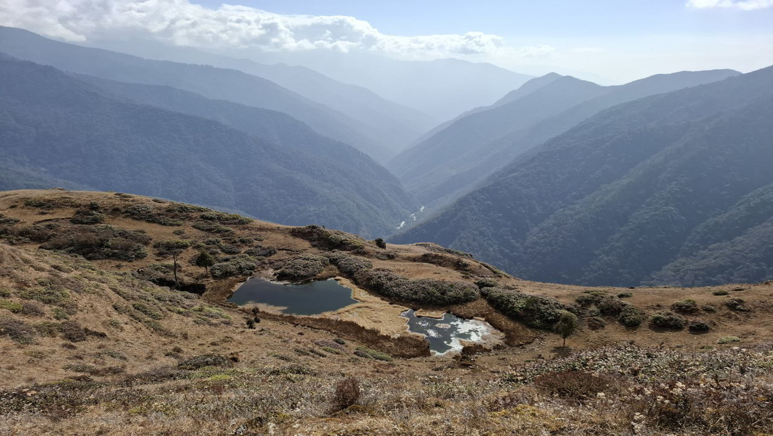
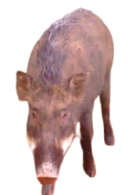
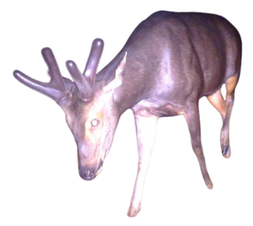
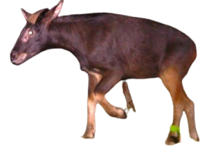
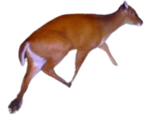
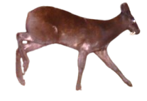
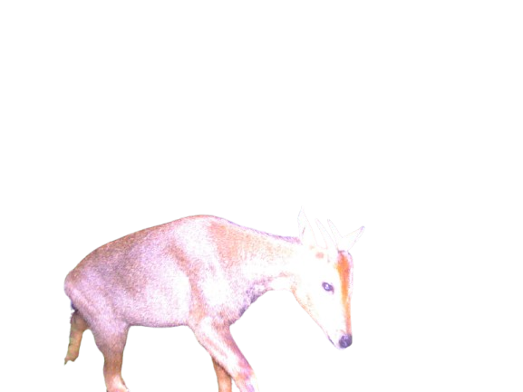
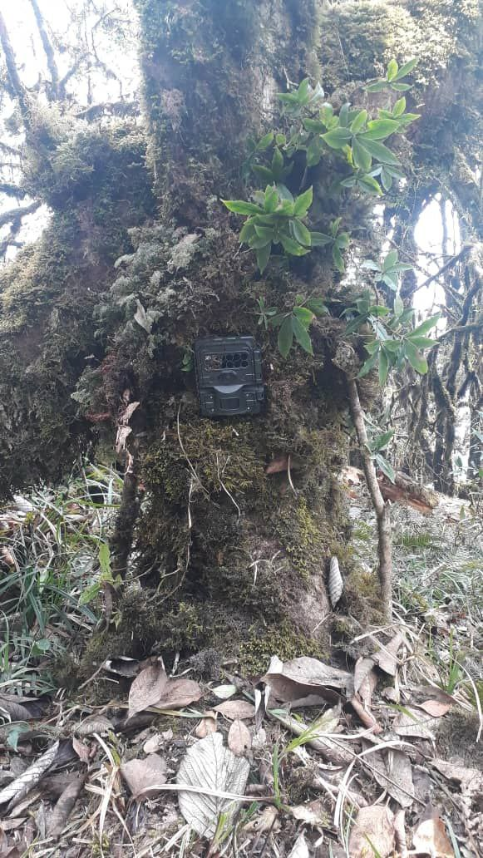

Prey Occupancy and Functional Connectivity
in Biological Corridor Seven (BC7), Bhutan
Jigme Thinley, Bhagat Suberi, Ugyen Dorji (CNR, Bhutan)
Transforming Asia: Sustainable Innovation in Agriculture, Food, Environment, Climate, and Development – 1.0
24–26 March 2026 · CNR, Lobesa, Punakha
24/03/2026
Notes:
[Sources]
- Background photo (Pho Chhu, Punakha, Bhutan): Wikimedia Commons “Phochu.jpg” (CC BY-SA 3.0).
- Camera trap photo: Wikimedia Commons “Camera trap.jpg” (CC BY-SA 3.0 / GFDL).
- Tiger photo: Wikimedia Commons “Bengal tiger.jpg” (public domain; U.S. Fish & Wildlife Service).
- Study content: Thinley, Suberi & Dorji (2025) BJNRD 12(2):5–18, DOI: 10.17102/cnr.2025.108.
[/Sources]

Slide 2
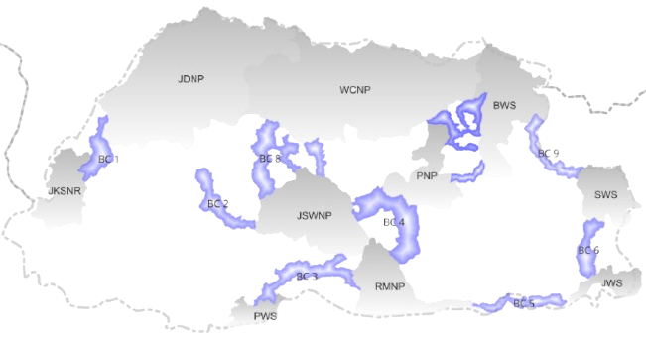
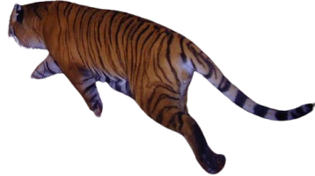
Background
Connectivity
Ecological connectivity = connectivity between core habitats across landscapes like BCs
Why prey matters in corridors
Conceptual view
Predator movement is strongly shaped by prey availability and distribution (Thinley et al., 2020).
Structural habitat maps can miss who actually uses the corridor (Hilty et al., 2020).
Multi-species approaches reduce single-species bias for management decisions (Adikari et al., 2024).
PA
corridor
PA
BC7
Figure 1: Biological corridors in Bhutan
3
Notes:
[Sources]
- Thinley et al. (2025), Introduction (connectivity definition and motivation for prey-based functional connectivity).
- Tiger image: Wikimedia Commons “Bengal tiger.jpg” (public domain).
[/Sources]

Slide 3
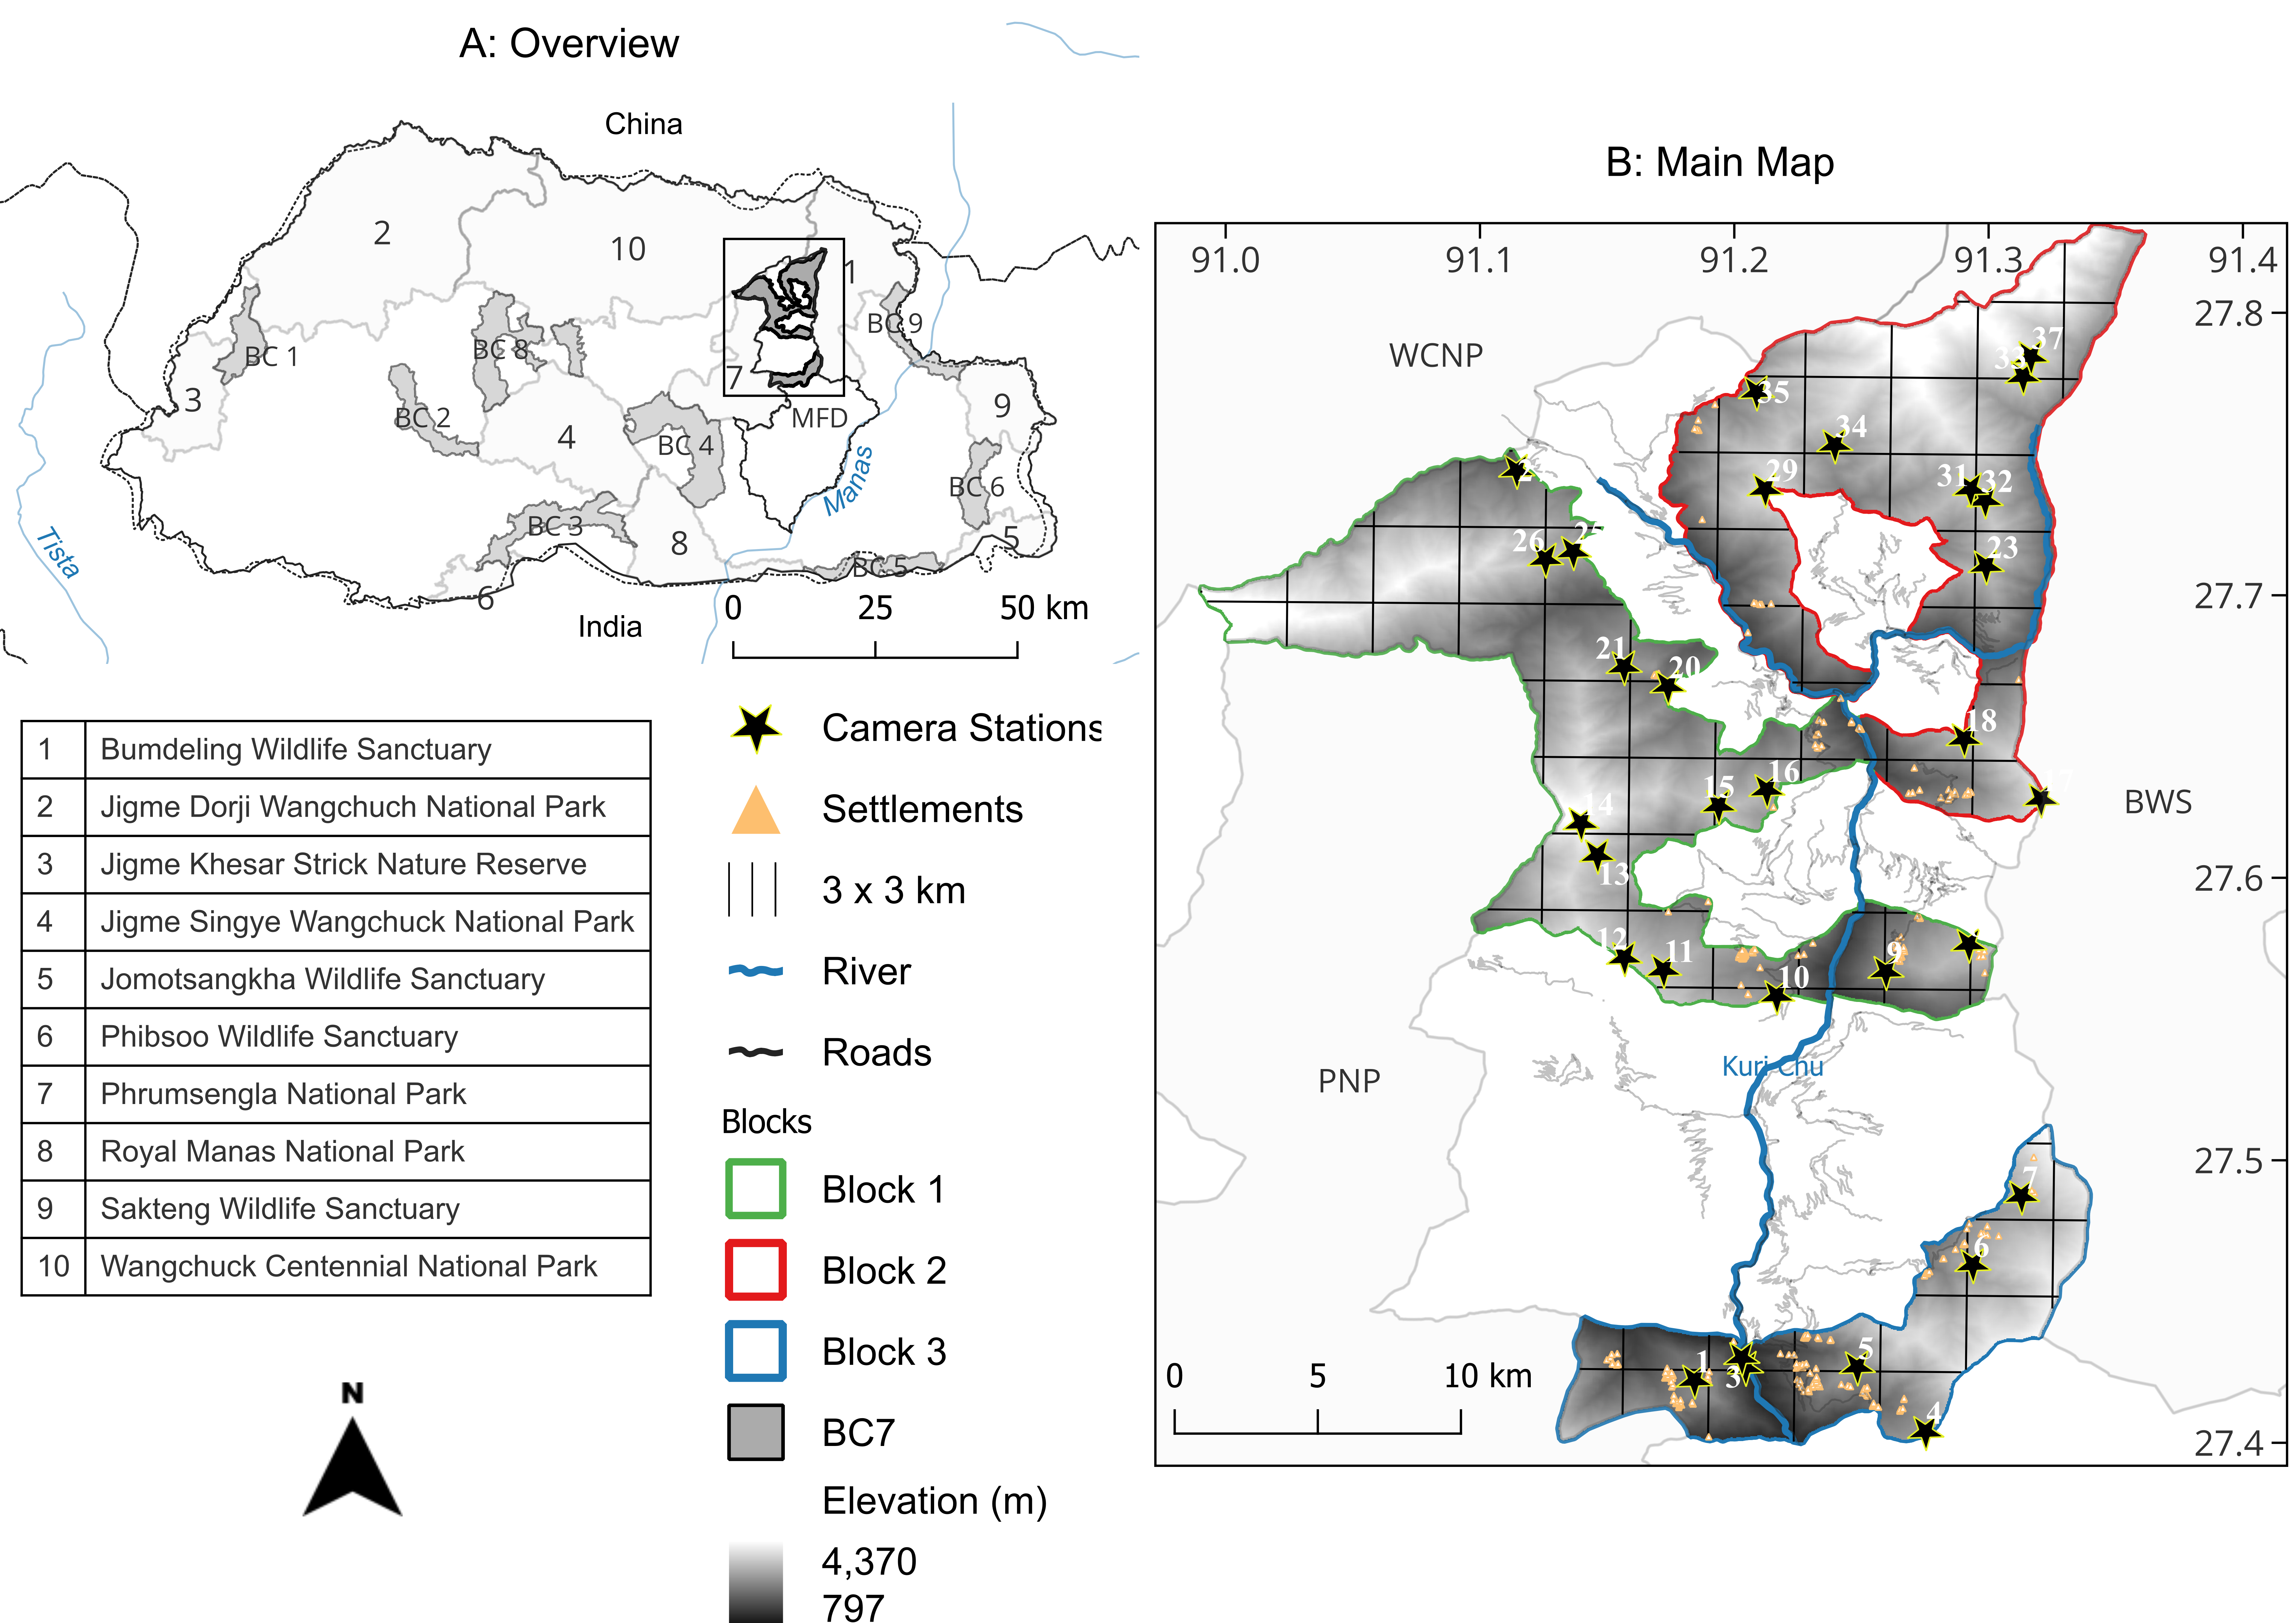
Study area & objectives
BC7
Biological Corridor Seven (BC7) (DFOM, 2023)
Links WCNP ↔ PNP ↔ BWS (northeast Bhutan).
419 km²; elevation ~800–4,370 m; broadleaf forests dominate.
Increasing pressure from roads, hydropower, and transmission lines.
Objectives
1) Estimate multi-species, multi-season occupancy (ψ) and detection (p) for six ungulate prey.
2) Map movement concentration and identify pinch points for mitigation.
Figure 2: Study area & sampling design
3
Notes:
[Sources]
- Thinley et al. (2025), Figure 1 and Study Area section.
[/Sources]

Slide 4
Research gap
Why this approach
In Bhutan, corridor assessments often:
Focus on a single species or a single season (Letro et al., 2022).
Rely on structural proxies (habitat suitability) rather than verified use.
Do not link occupancy patterns to a connectivity model for bottlenecks.
This study adds:
Multi-species, multi-season occupancy → spatial predictions (500 m grid).
Random-walk connectivity → pinch points + road/river conflict segments.
Actionable screening layer for crossings & adaptive corridor management.
4
Notes:
[Sources]
- Thinley et al. (2025), Introduction (gap statement) and Methods.
[/Sources]

Slide 5
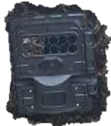
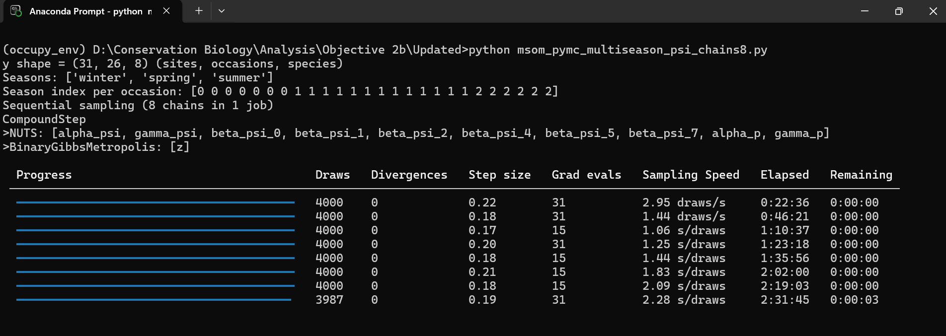
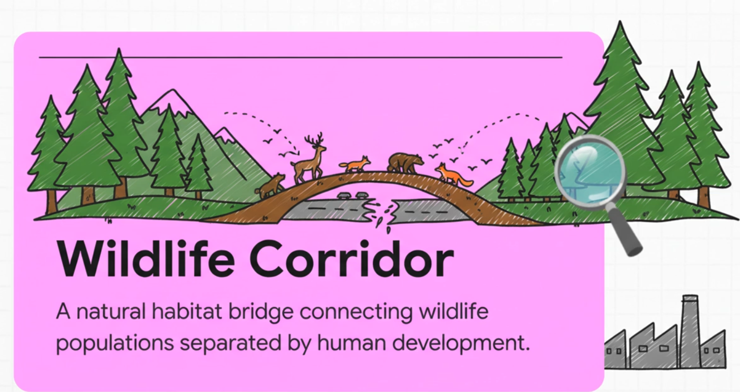
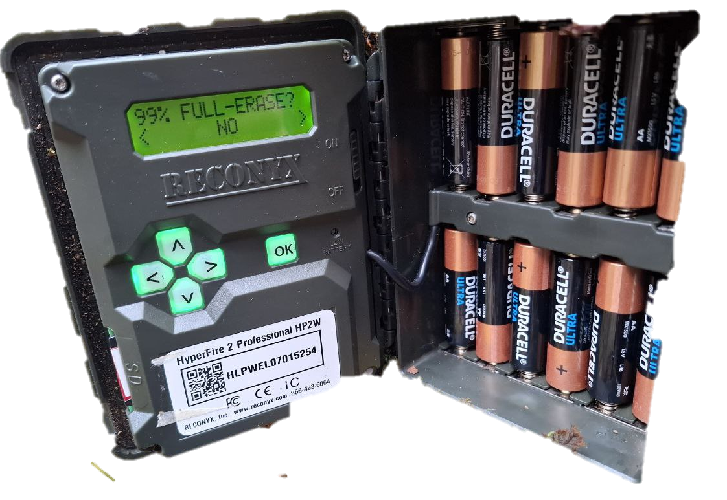
Methods overview
Workflow
Integrated occupancy → connectivity workflow
Camera traps
(31 paired stations)
Bayesian MSOM
ψ & p (PyMC v5)
Random‑walk
connectivity
Pinch points
+ conflicts
Detection histories
(7‑day occasions)
Occupancy surface
500 m grid
Key modelling idea
Use predicted occupancy (ψ) as conductance (movement potential) and derive a multi-species current-density surface to locate pinch points (Downey, 2021).
5
Notes:
[Sources]
- Thinley et al. (2025), Methods (Occupancy modelling; Spatial prediction & connectivity).
[/Sources]

Slide 6

Data collection
Camera traps
Sampling effort
• 5,144 trap days
• 822 independent events
• Two cameras per station
• ≥1 km spacing
Seasons
Winter (Jan–Feb)
Spring (Mar–May)
Summer (Jun–Jul)
Focal prey (6)
Generalists: barking deer, sambar, wild pig
Specialists: goral, serow, musk deer
Fig 2B:31 stations on a 3 km × 3 km grid (Jan–Jul 2025)
6
Notes:
[Sources]
- Thinley et al. (2025), Sampling Design and Species selection.
[/Sources]

Slide 7
Occupancy modelling
Bayesian MSOM
Model (Downey, 2021)
Covariates
Hierarchical Bayesian multi-species, multi-season occupancy model (MSOM)
• Occupancy: ψ (site covariates)
• Detection: p (site + occasion; season-specific intercepts)
• Binary detections per 7‑day occasion
Canopy cover
Human Footprint Index
Slope, temperature, precipitation
Distance to roads/protected areas/settlements
Land use/forest type (LULC)
Computation
PyMC v5 (NUTS)
• 12 chains
• 10,000 warm-up + 10,000 draws
• target_accept = 0.98
Output surfaces
Predicted ψ mapped to a 500 m × 500 m grid (N = 1,689 cells) for connectivity modelling.
7
Notes:
[Sources]
- Thinley et al. (2025), Occupancy Modelling + Spatial prediction sections.
[/Sources]

Slide 8
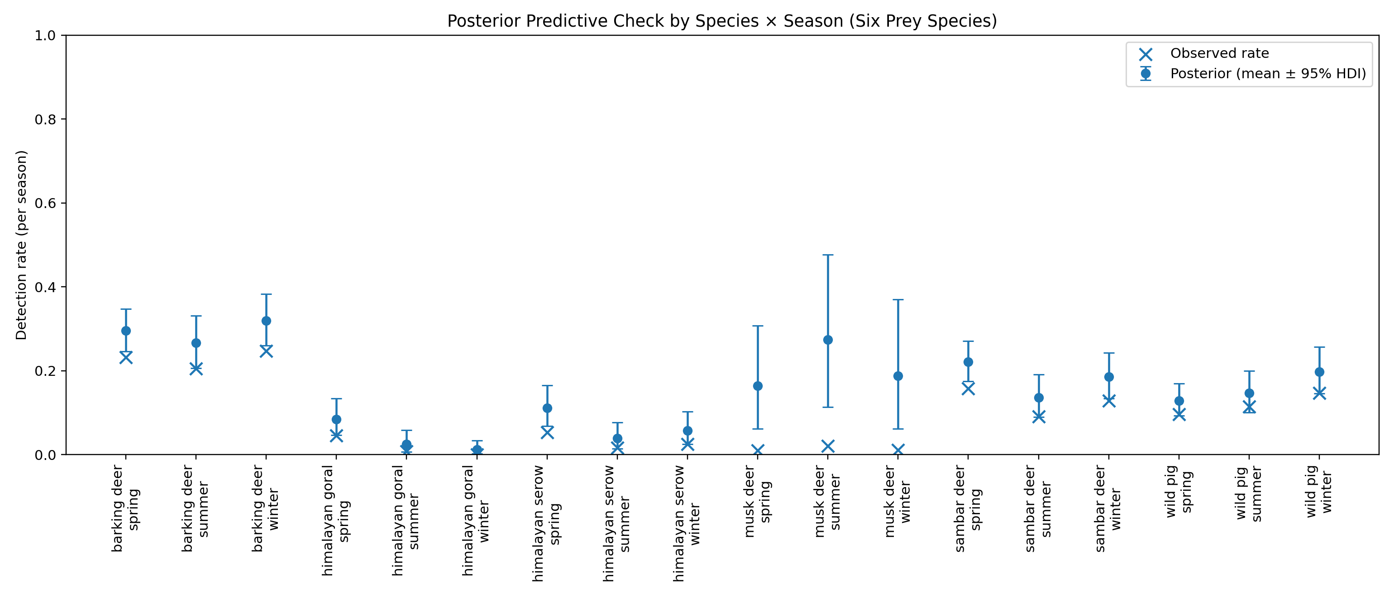
I Model performance
Fit & diagnostics
Fit summary
• Brier score ≈ 0.055
• Strong convergence (R̂ ≤ 1)
• p spans ~0.013–0.320
Interpretation
PPCs show predicted vs observed detection means align well across species and seasons → suitable for spatial prediction and screening-level connectivity mapping.
Figure 3: Posterior predictive checks (mean detection rates by species × season)
8
Notes:
[Sources]
- Thinley et al. (2025), Results: Sampling effort & model performance; Figure 2.
[/Sources]

Slide 9
II Prey occupancy and Hotspots
Table 1: Prey occupancy (ψ) across 31 camera stations
Barking deer
Musk deer
Barking deer
Serow
Musk deer
Species | Category | Min ψ | Station | Max ψ | Station
Barking deer | Generalist | 0.23 | CS14 (3,687 m) | 0.99 | CS09 (2,150 m)
Sambar deer |  | 0.07 | CS14 (3,687 m) | 0.98 | CS20 (2,132 m)
Wild pig |  | 0.22 | CS03 (861 m) | 0.94 | CS11 (2,885 m)
Goral | Specialist | 0.14 | CS10 (2,149 m) | 0.87 | CS37 (3,281 m)
Serow |  | 0.11 | CS20 (2,132 m) | 0.90 | CS13 (3,218 m)
Musk deer |  | 0.01 | CS20 (2,132 m) | 0.65 | CS14 (3,687 m)
Goral
Sambar deer
Wild pig
Marked difference between generalists and specialists–elevation, disturbance and canopy.
….Higher ψ than BC8 (Letro et al., 2022)
Figure 4: Occupancy pattern of prey species
…. likely reflecting the suitability and minimal
disturbance within BC7.
9
Notes:
[Sources]
- Thinley et al. (2025), Figure 3 and Results: Seasonal detection. Line chart uses averages computed from the labeled point estimates in Figure 3.
[/Sources]

Slide 10
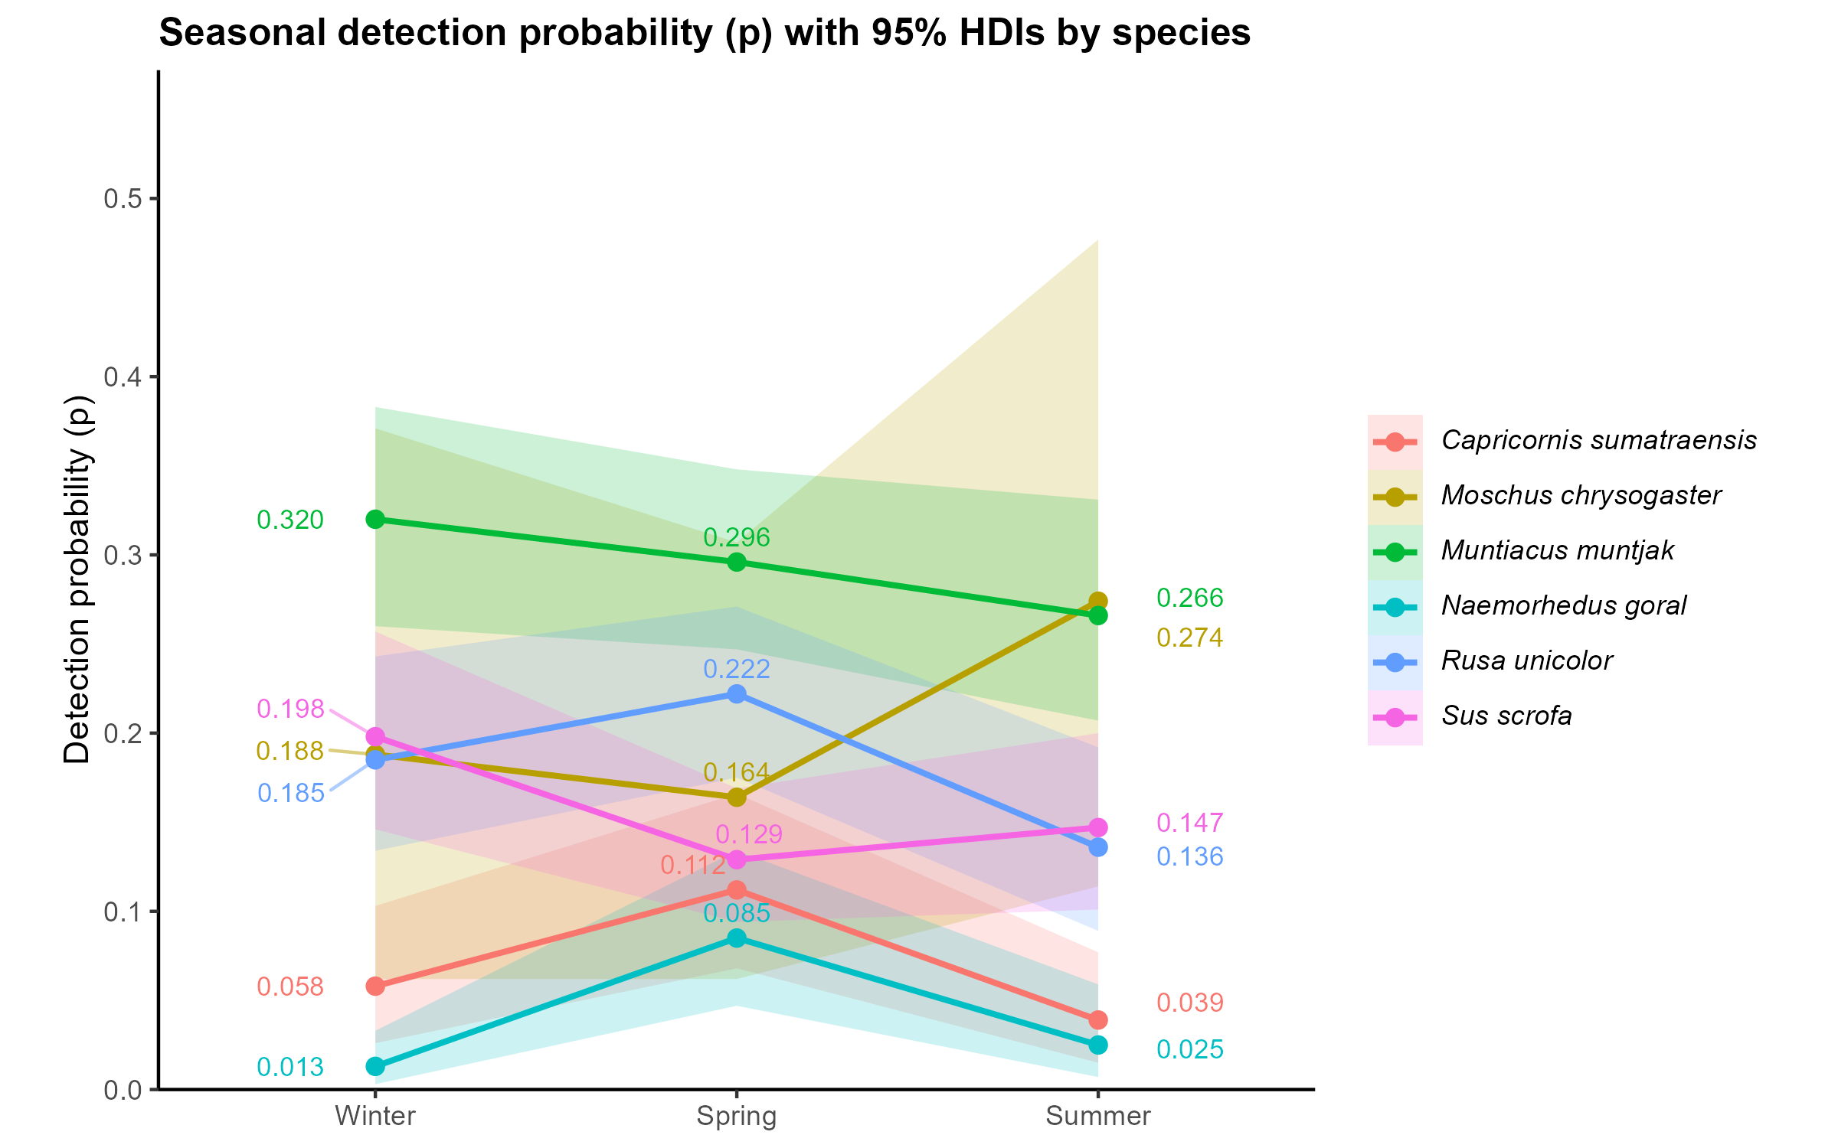
III Seasonal detection
Figure 5: Group-average pattern
Statistics
• Generalists: highest p in winter (trail use/visibility).
• Specialists: low in winter; peak in spring (snowmelt + new forage).
• Musk deer shows a comparatively stable signal.
Figure 5: Detection probability (p) by season (with 95% HDIs)
10
Notes:
[Sources]
- Thinley et al. (2025), Figure 3 and Results: Seasonal detection. Line chart uses averages computed from the labeled point estimates in Figure 3.
[/Sources]

Slide 11
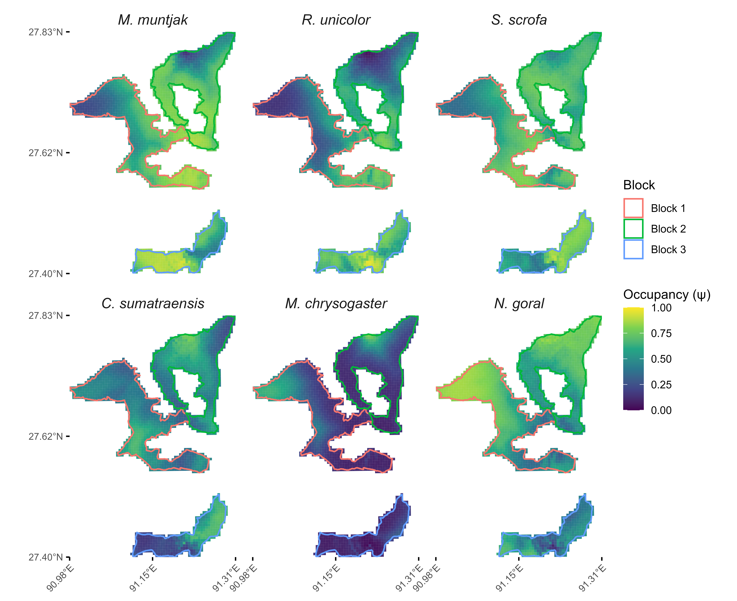
IV Spatial prediction
Occupancy surfaces
What stands out
• Barking deer, sambar, wild pig: broad coverage.
• Specialists: narrower bands (mostly Blocks 1–2).
Management hint
Protect high-elevation refugia and mid-elevation riparian corridors that support both generalists and specialist pathways.
Figure 6: Predicted occupancy (ψ) mapped across a 500 m grid (N = 1,689).
11
Notes:
[Sources]
- Thinley et al. (2025), Results: Predicted occupancy and movement corridors; Figure 5.
[/Sources]

Slide 12
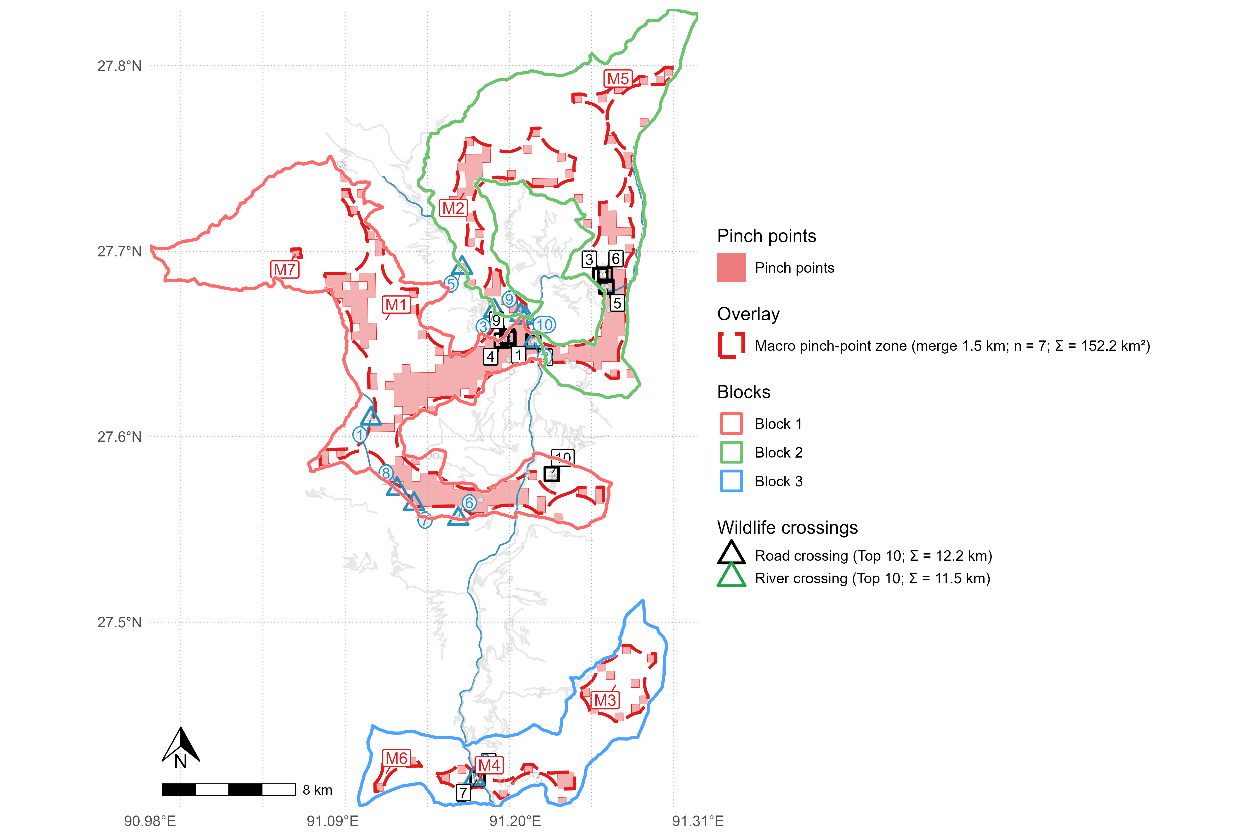
V Connectivity and wildlife crossings
Pinch points
Pinch points
• 7 macro pinch-point zones (M1–M7)
• Total ≈ 152 km²
• Concentrated mainly in Blocks 1–2
How to use this map
Treat as a screening layer: prioritise field verification, then co-design crossings with engineering feasibility and local community inputs.
Figure 7: Pinch points + proposed crossing candidates along roads and rivers
12
Notes:
[Sources]
- Thinley et al. (2025), Results: pinch points; Figure 6.
[/Sources]

Slide 13
Conclusions
Take-home
Three take-home messages
BC7 remains a prey-rich linkage between protected areas; generalists show high, widespread occupancy.
Specialists concentrate on narrower upper-elevation routes → higher fragmentation risk.
Pinch points provide a defensible screening layer for crossings, fencing, and riparian buffers as infrastructure expands.
Next steps
Field-verify candidate segments (traffic, roadkill, community observations).
Extend surveys to additional seasons and validate with telemetry/genetics.
13
Notes:
[Sources]
- Thinley et al. (2025), Conclusion & Study limitations.
[/Sources]

Slide 14
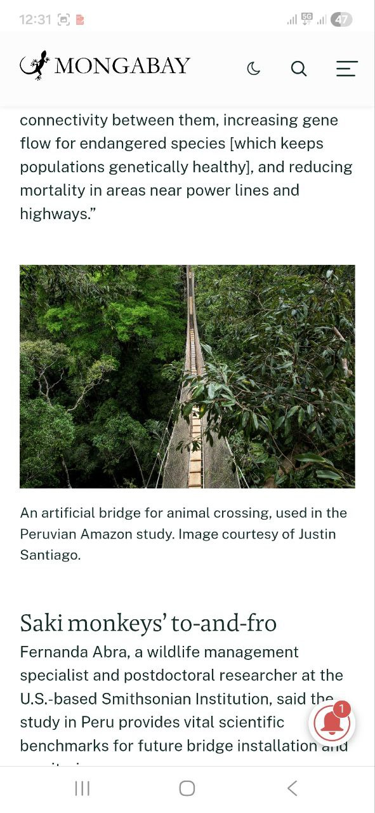
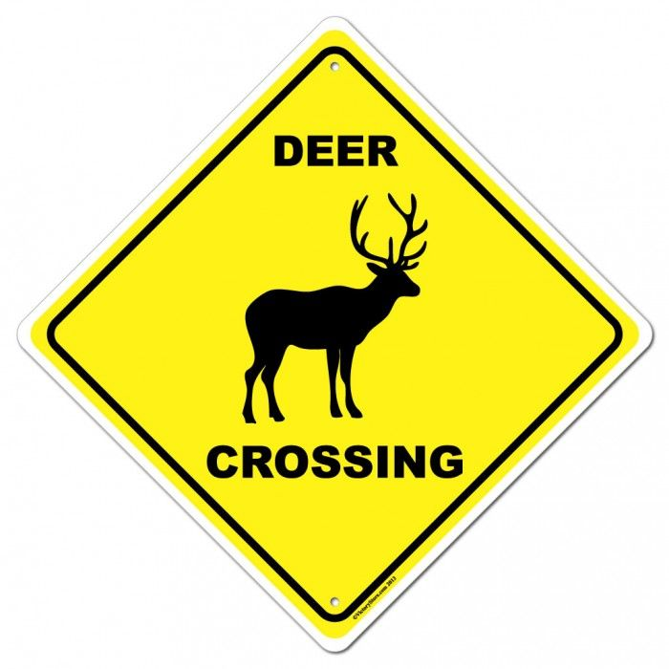
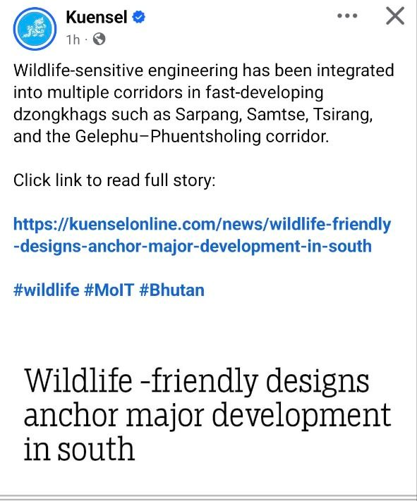
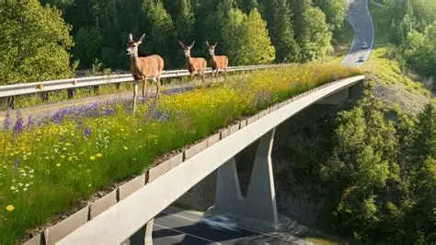
Examples of Wildlife Crossings
Take-home
https://i.pinimg.com/736x/97/17/14/971714ca2cffb71ab20ead4126a9609f--deer-crossing-street-signs.jpg
https://www.liveinsurancenews.com/wildlife-crossings-saving-auto/8565150/
14
Notes:
[Sources]
- Thinley et al. (2025), Conclusion & Study limitations.
[/Sources]

Slide 15








Acknowledgement
Appreciations
15
Notes:
[Sources]
- Thinley et al. (2025), Conclusion & Study limitations.
[/Sources]

Slide 16
References
Adhikari, J. N., Bhattarai, B. P., Baral, S., & Thapa, T. B. (2024). Landscape-level habitat connectivity of large mammals in Chitwan-Annapurna Landscape, Nepal. Ecology and Evolution. https:// doi.org/10.1002/ece3.70087
Devarajan, K., Morelli, T. L., & Tenan, S. (2020). Multi-species occupancy models: review, roadmap, and recommendations. Ecography, 43(11), 1612–1624.
Dickson, B. G., et al. (2019). Circuit-theory applications to connectivity science and conservation. Conservation Biology, 33(2), 239–249.
Hilty, J., et al. (2020). Guidelines for conserving connectivity through ecological networks and corridors. IUCN.
Thinley, P., Dendup, T., Rajaratnam, R., Vernes, K., Tempa, K., Chophel, T., & Norbu, L. (2020). Tiger reappearance in Bumdeling Wildlife Sanctuary: a case for maintaining effective corridors and metapopulations. Animal Conservation, 23(6), 629-631.
Thank you • Questions?
16
Notes:
[Sources]
- Reference list derived from Thinley et al. (2025) reference section.
[/Sources]

